Slide 1
Copying Files during the build
Sameer Zulfi

Slide 2
Objectives
So far, we have installed things in our container images by downloading packages.
We can also copy files from the build context to the container that we are building.
Remember: the build context is the directory containing the Dockerfile.
In this chapter, we will learn a new Dockerfile keyword: COPY.

Slide 3

Let’s Build some C Code
We want to build a container that compiles a basic “Hello World” program in C
Create a directory and make sure you have two files ( c file and Dockerfile )
Here is the program, hello.c :

Slide 4
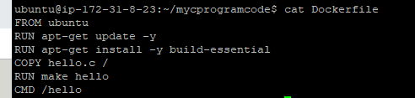
The Dockerfile
On Debian and Ubuntu, the package build-essential will get us a compilers like gcc, make, g++ etc.,
Create the below Dockerfile
FROM base image as Ubuntu
RUN apt-get update –y will update the s/w packages
RUN apt-get install –y build-essential will install all the compilers
COPY the hello.c file from the host machine to inside the container root directory “/”
Then RUN the command “make hello” which is alternative of gcc compiler. I hope you remember your college days C stuffs. ☺
CMD will start the hello program as soon as container starts

Slide 5

Testing our C Program
Make sure both the below files are in the same directory.
Let’s build it.
docker build –t hello .
Let’s test it by running the container and see whether we are getting “hello world “ or not.
Congratulations. We are done.

Slide 6

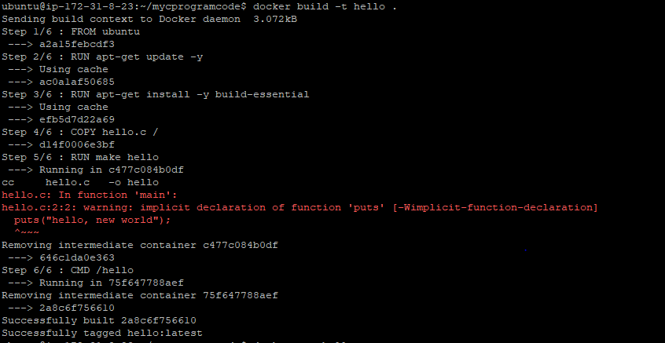
COPY and the build cache
Now, modify the hello.c and run the build again.
Docker can cache steps involving COPY.
Let’s modify the hello.c
Let’s build it again
Please closely analyse this screen
And see how fast it built comparing
First time and uses Cache if you see
In the output

